Slide 1
TREATMENT OF INFECTIOUS DISEASES

Slide 2
The key components of treating infectious disease are:
•Address any identifiable predisposing factor, e.g. diabetes mellitus or known immune deficit (HIV, neutropenia).
• Antimicrobial therapy.
•Adjuvant therapy, without which eradication of infection is unlikely, e.g. removal of an indwelling catheter (urinary or vascular), abscess drainage or débridement of an area of necrotising fasciitis.
•Treatment of the consequences of infection, e.g. the systemic inflammatory response syndrome(SIRS), inflammation and pain.

Slide 3
For communicable disease, treatment must also take into account contacts of the infected patient, and may include infection prevention and control activities such as isolation, antimicrobial prophylaxis, vaccination and contact tracing.

Slide 4
Principles of antimicrobial therapy:
When infection is diagnosed, it is often important to start antimicrobial therapy promptly.

Slide 5
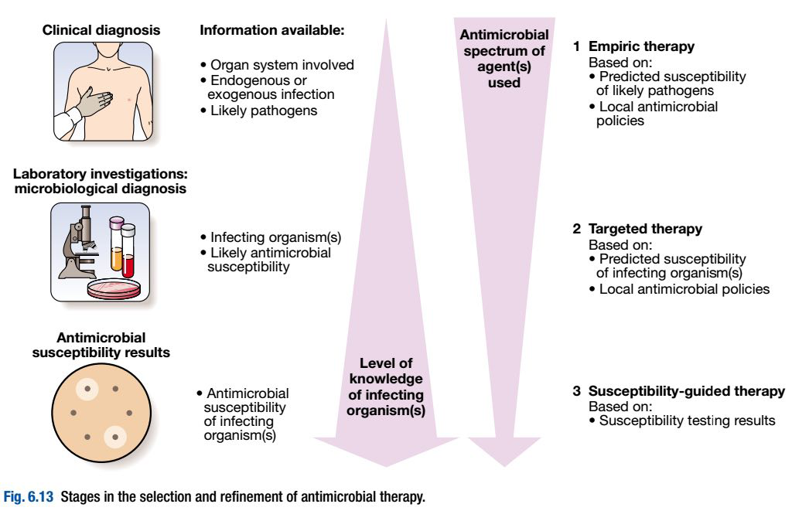

Slide 6
Antimicrobial action and spectrum:
Antimicrobial agents bring about killing by inhibiting, damaging or destroying a target that is a required component of the organism.
Every antimicrobial agent is able to kill a specific range of microorganisms, and this must be considered in selecting appropriate antimicrobial therapy.

Slide 7
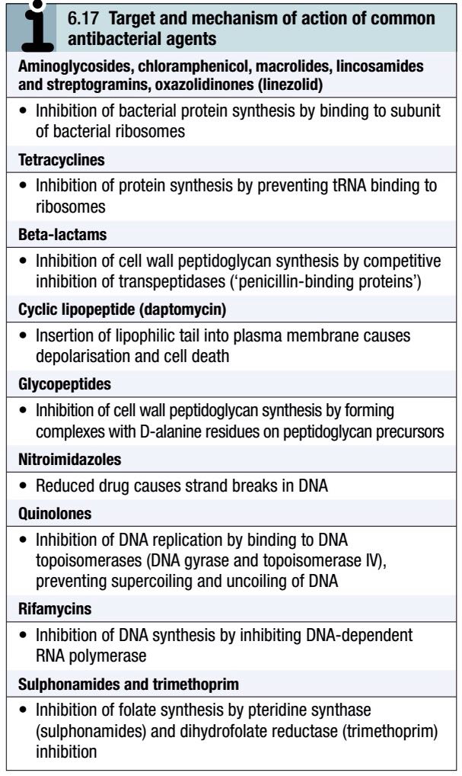
The mechanisms of action of the major classes of antibacterial agent :

Slide 8
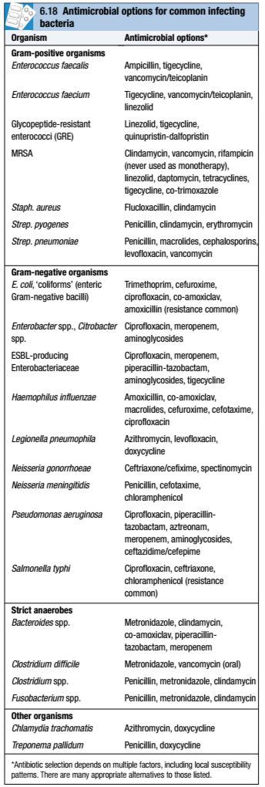
Appropriate antibiotic choices for a range of common infecting organisms:

Slide 9
In severe infections and/or immunocompromised patients, it is customary to use bactericidal agents in preference to bacteriostatic agents.

Slide 10
Empiric versus targeted therapy:
Empiric antimicrobial therapy is selected to treat a clinical syndrome (e.g. meningitis) before a microbiological diagnosis has been made.
Targeted therapy is aimed at the causal pathogen(s) of known antimicrobial sensitivity.
Ideally, broad-spectrum agents are used in empiric therapy, and narrow-spectrum agents in targeted therapy.

Slide 11
Optimum empiric therapy differs according to clinical presentation (e.g. pneumonia versus meningitis), patient groups (e.g. children, immunocompromised hosts) and local antimicrobial resistance patterns.
Hospitals should establish local antibiotic policies to guide rational antimicrobial prescribing, maximising efficacy while minimising antimicrobial resistance and cost.

Slide 12
Combination therapy:
Antimicrobial combination therapy is usually restricted to three settings:
1.to increase efficacy (e.g. enterococcal endocarditis, where a β-lactam/aminoglycoside combination results in better outcomes than a β-lactam alone).

Slide 13
2.when no single agent’s spectrum covers all potential pathogens (e.g. in polymicrobial infection or empiric treatment of sepsis)
3.to reduce antimicrobial resistance, as the organism would need to develop resistance to multiple agents simultaneously (e.g. antituberculous chemotherapy, highly active anti-retroviral therapy (HAART)).

Slide 14
Antimicrobial resistance:
Microorganisms have evolved in the presence of antibiotics, which are antimicrobial agents produced naturally by bacteria and fungi.
They have therefore developed multiple resistance mechanisms to all classes of antimicrobial agent (antibiotics and their derivatives).

Slide 15
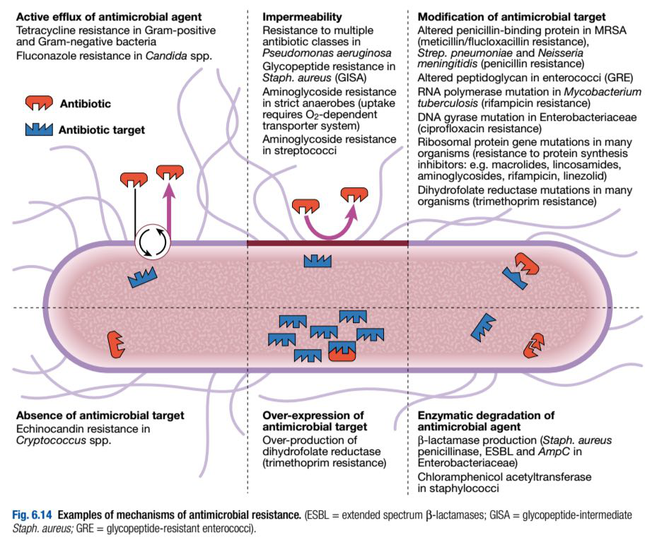

Slide 16
Resistance may be an innate property of a microorganism (intrinsic resistance) or may be acquired, by either spontaneous mutation or horizontal transfer of genetic material from another organism.
For some agents, e.g. penicillins, a degree of resistance occurs in vivo when the bacterial load is high and the molecular target for the antimicrobial is down-regulated (an ‘inoculum effect’).

Slide 17
The mecA gene encodes a low-affinity penicillin-binding protein, which confers resistance to meticillin and other penicillinase-resistant penicillins in Staph. aureus.
It is common for plasmids to encode resistance to multiple antimicrobials, which may be transferred horizontally.

Slide 18
Extended spectrum β-lactamases (ESBL) are encoded on plasmids, which are transferred relatively easily between bacteria including Enterobacteriaceae.
Plasmid-mediated carbapenemases have been detected in strains of Klebsiella pneumoniae.

Slide 19
Glycopeptide resistance in enterococci is also transferred on mobile genetic elements.
Strains of MRSA have been described that exhibit intermediate resistance to glycopeptides, through the development of a relatively impermeable cell wall (GISA).

Slide 20
Factors implicated in the emergence of antimicrobial resistance include the inappropriate use of antibiotics when not indicated (e.g. in viral infections), inadequate dosage or treatment duration, excessive use of broad-spectrum agents, and use of antimicrobials as growth-promoters in agriculture.
However any antimicrobial use exerts a selection pressure that favours the development of resistance.

Slide 21
Combination antimicrobial therapy may reduce the emergence of resistance.
This is recommended in treatment of patients infected with HIV, which is highly prone to spontaneous mutation.

Slide 22
Despite use of combination therapy for M. tuberculosis, multidrug-resistant TB (MDR-TB, resistant to isoniazid and rifampicin) and extremely drug-resistant TB (XDR-TB, resistant to isoniazid and rifampicin, any fluoroquinolone, and at least one injectable antimicrobial antituberculous agent) have been reported worldwide and are increasing in incidence.

Slide 23
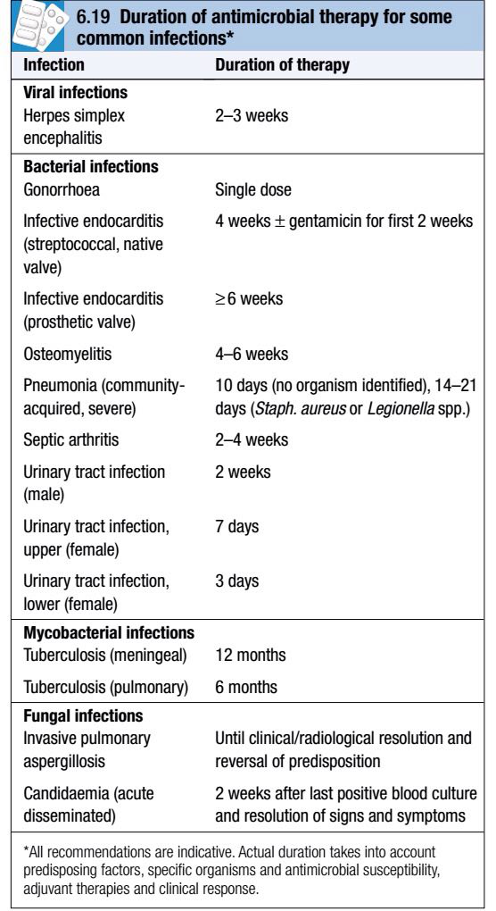
Duration of therapy:
Treatment duration generally reflects severity of infection and the accessibility of the infected site to antimicrobial agents.
For most infections there is limited clinical evidence available to support a specific duration of treatment.

Slide 24
When initial therapy is intravenous, it is often possible to switch to oral therapy after a patient has been apyrexial for approximately 48 hours.
In the absence of specific guidance, antimicrobial therapy should be stopped when there is no longer any clinical evidence of infection.

Slide 25
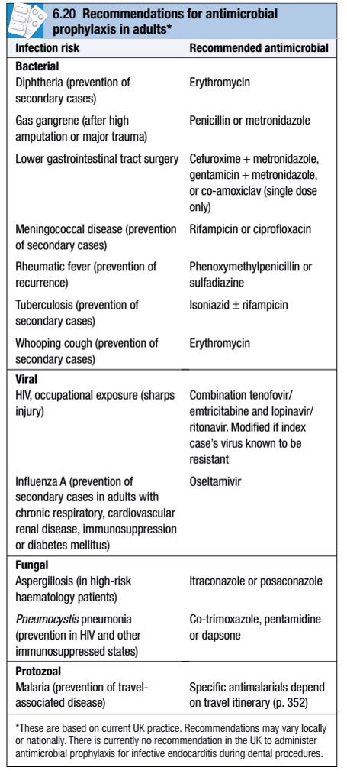
Antimicrobial prophylaxis:
Prophylaxis is used when there is a risk of infection from a procedure or exposure

Slide 26
It may be combined with (or replaced by) passive immunisation.
Ideally, prophylaxis should be of short duration, have minimal adverse effects and not encourage growth of resistant pathogens.

Slide 27
Pharmacokinetics and pharmacodynamics:
Pharmacokinetics of antimicrobial agents determine whether adequate concentrations are obtained at the primary site of infection and likely areas of dissemination.
Septic patients often have poor gastrointestinal absorption, so the preferred initial route of therapy is intravenous.

Slide 28
Knowledge of anticipated antimicrobial drug concentrations at sites of infection is critical.
For example, achieving a ‘therapeutic’ blood level of gentamicin is of little practical use in treating meningitis, as CSF penetration of the drug is severely limited.

Slide 29
Knowledge of routes of elimination is also critical in antimicrobial therapy; for instance, a urinary tract infection is more appropriately treated with a drug that is excreted unchanged in the urine than one which is fully eliminated by hepatic metabolism.

Slide 30
Pharmacodynamics describes the relationship between antimicrobial concentration and microbial killing.
For many agents, antimicrobial effect can be categorised as concentration-dependent or time-dependent.

Slide 31
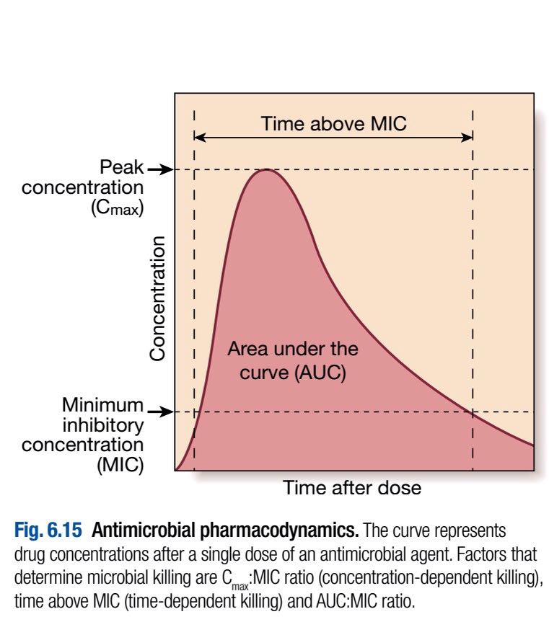

Slide 32
The maximum concentration achieved is C_{max} and the measure of overall exposure is the area under the curve (AUC).
The efficacy of antimicrobial agents whose killing is concentration-dependent (e.g. aminoglycosides) increases with the amount by which C_{max} exceeds the minimum inhibitory concentration (C_{max}:MIC ratio).

Slide 33
For this reason, it has become customary to administer aminoglycosides (e.g. gentamicin) infrequently at high doses (e.g. 7mg/kg) rather than frequently at low doses.
This has the added advantage of minimising toxicity by reducing the likelihood of drug accumulation.

Slide 34
Conversely, the β-lactam antibiotics, macrolides and clindamycin exhibit time-dependent killing, and their efficacy depends on C_{max} exceeding the MIC for a certain time (which is different for each class of agent).

Slide 35
This is reflected in the dosing interval of benzylpenicillin, which is usually given every 4 hours in severe infection (e.g. meningococcal meningitis), and may be administered by continuous intravenous infusion.

Slide 36
For other antimicrobial agents the relationships between MIC, C_{max} and AUC are more complex and often less well understood.
With some agents bacterial inhibition persists after antimicrobial exposure (post-antibiotic and post-antibiotic sub-MIC effects).

Slide 37
Therapeutic drug monitoring:
Therapeutic drug monitoring is used to confirm non-toxic levels of antimicrobial agents with a low therapeutic index (e.g. aminoglycosides), and to confirm effective levels (if these are known) of agents with marked inter-patient pharmacokinetic variability (e.g. vancomycin, itraconazole).

Slide 38
Specific recommendations for monitoring depend on individual drugs and regimens, so specialist advice should be sought.
For instance, different pre- and post-dose levels of gentamicin are recommended depending on whether it is being used in traditional divided doses, once daily or for synergy in endocarditis.

Slide 39
Beta-lactam antibiotics:
These antibiotics have a β-lactam ring structure and exert a bactericidal action by inhibiting enzymes involved in cell wall synthesis (penicillin-binding proteins, PBP).

Slide 40
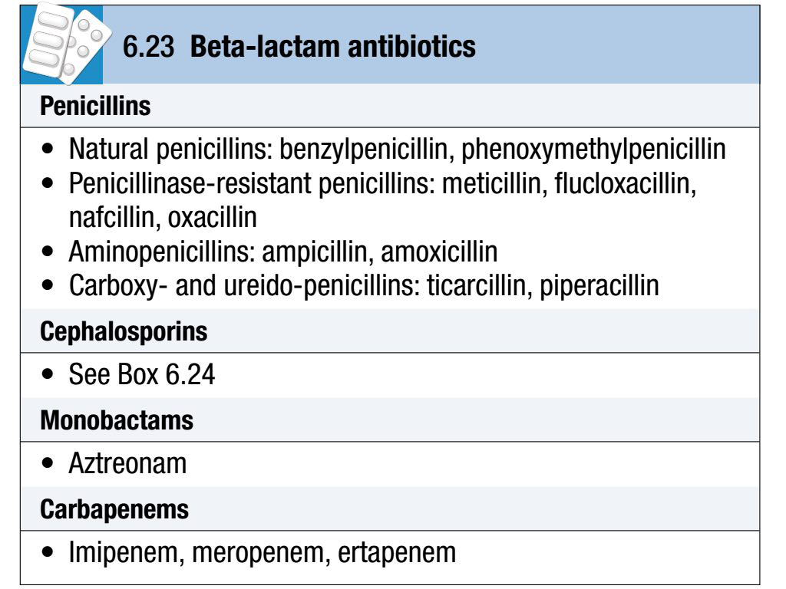

Slide 41
Pharmacokinetics:
• Good drug levels are achieved in lung, kidney, bone, muscle and liver, and in pleural, synovial, pericardial and peritoneal fluids.
• CSF levels are low, except in the presence of inflammation.
• Activity is not inhibited in abscess (e.g. by low pH and PO₂, high protein and polymorphonuclear cells).

Slide 42
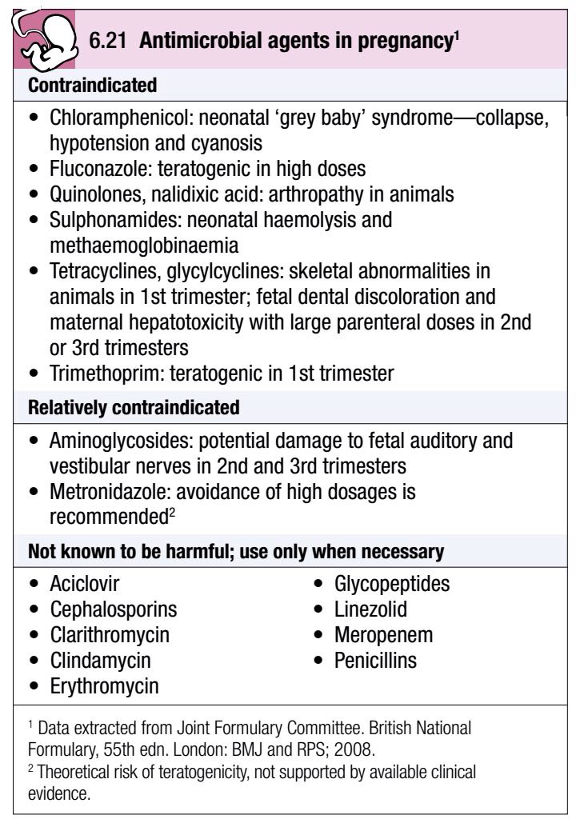
•β-lactams are subject to an ‘inoculum effect’—activity is reduced in the presence of a high organism burden (PBP expression is down-regulated by high organism density).
•Generally safe in pregnancy (except imipenem/cilastatin).

Slide 43
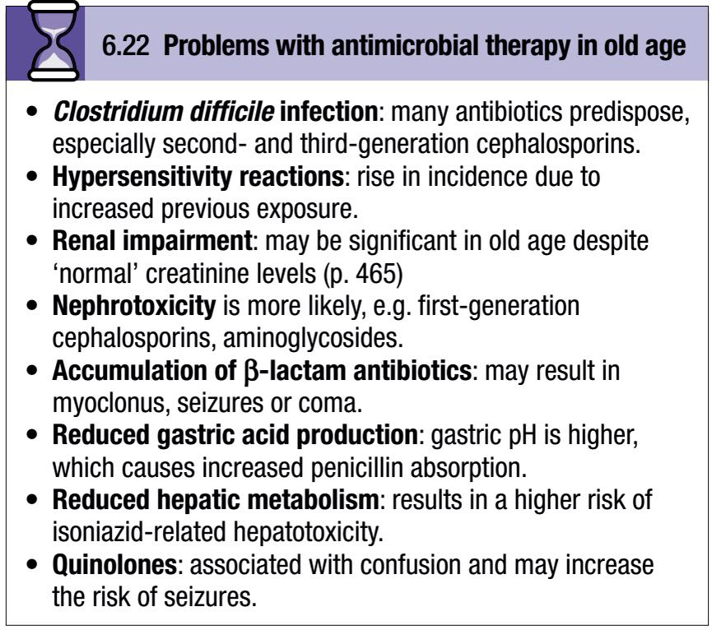

Slide 44
Adverse reactions:
Generalised allergy to penicillin occurs in 0.7–10% of cases and anaphylaxis in 0.004–0.015%. Over 90% of patients with infectious mononucleosis develop a rash if given aminopenicillins; this does not imply lasting allergy.
The relationship between allergy to penicillin and allergy to cephalosporins depends on the specific cephalosporin used.

Slide 45
Although there is significant cross-reactivity with first-generation cephalosporins, cross-reactivity to second- and third-generation cephalosporins is much less common (and may be negligible with some agents).
However, it is usually recommended to avoid cephalosporins in patients who have a type 1 penicillin allergy (e.g. anaphylaxis, urticaria, angio-oedema).

Slide 46
Gastrointestinal upset and diarrhoea are common, and a mild reversible hepatitis is well recognised with many β-lactams.
Leucopenia, thrombocytopenia and coagulation deficiencies can occur.
Interstitial nephritis and increased renal damage in combination with aminoglycosides are also recognised.

Slide 47
Seizures and encephalopathy have been reported, particularly with high doses in the presence of renal insufficiency.
Thrombophlebitis occurs in up to 5% of patients receiving parenteral β-lactams.
Direct intrathecal injection of a β-lactam is contraindicated.

Slide 48
Drug interactions:
Synergism occurs in combination with aminoglycosides.
Simultaneous dual β-lactam administration can result in either synergy or antagonism.
Ampicillin decreases the biological effect of oral contraceptives and the whole class is significantly affected by concurrent administration of probenecid, producing a 2–4-fold increase in the peak serum concentration.

Slide 49
Penicillins:
Natural penicillins are primarily effective against Gram-positive organisms (except staphylococci, most of which produce a penicillinase) and anaerobic organisms.
Strep. pyogenes has remained sensitive to natural penicillins world-wide.

Slide 50
The prevalence of penicillin resistance in Strep. pneumoniae in Europe in 2006 was 9%.
This figure includes both low- and high-level resistance (non-severe infections with low-level resistant strains may be treated with high-dose penicillins).

Slide 51
Penicillinase-resistant penicillins are the mainstay of treatment for infections with Staph. aureus, other than meticillin-resistant strains (MRSA).
In 2006 24% of invasive Staph. aureus isolates in Europe were meticillin-resistant.

Slide 52
Aminopenicillins have the same spectrum of activity as the natural penicillins, with additional Gram-negative cover against Enterobacteriaceae.

Slide 53
Amoxicillin has much better oral absorption than ampicillin.
Resistance to these agents is widespread (57% of E. coli in the UK in 2006), mainly due to β-lactamase production, but can be overcome by the addition of β-lactamase inhibitors (clavulanic acid or sulbactam).

Slide 54
Carboxy- and ureidopenicillins are particularly active against Gram-negative organisms, especially Pseudomonas spp. which are resistant to the aminopenicillins.
Beta-lactamase inhibitors may be added to extend their spectrum of activity.

Slide 55
Cephalosporins and cephamycins:
Cephalosporins are safe and reliable and have a broad spectrum of activity.
The more active compounds are only available in intravenous form.
They are significantly associated with C. difficile infection (CDI).

Slide 56
The group has no activity against Enterococcus spp. and little anti-anaerobic activity (with the exception of cephamycins).
Cephalosporins are arranged in ‘generations’.

Slide 57
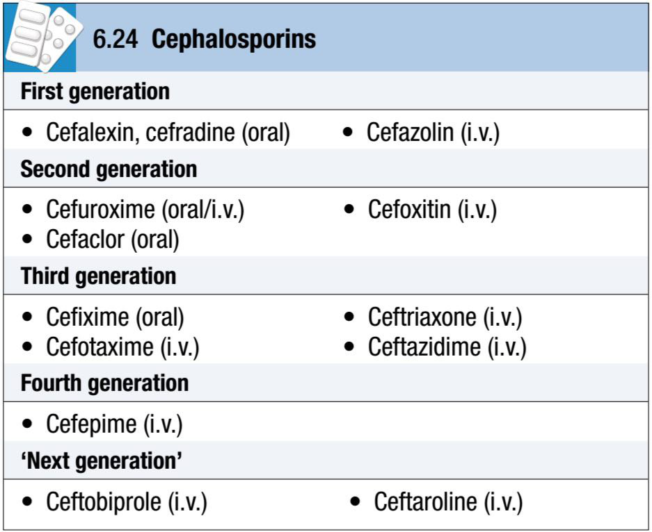

Slide 58
•First-generation compounds have excellent activity against Gram-positive organisms and some activity against Gram-negative ones. Many of them are potentially nephrotoxic.

Slide 59
• Second-generation drugs retain Gram-positive activity but have extended Gram-negative activity. Cephamycins (e.g. cefoxitin), which are included in this group, have good activity against anaerobic Gram-negative bacilli.

Slide 60
•Third-generation agents further improve anti-Gram-negative cover. For some (e.g. ceftazidime), this is extended to include Pseudomonas spp. Cefotaxime and ceftriaxone have excellent Gram-negative activity and retain good activity against Strep. pneumoniae and β-haemolytic streptococci. Ceftriaxone is administered once daily, and is therefore a suitable agent for outpatient antimicrobial therapy.

Slide 61
•Fourth-generation agents have an extremely broad spectrum of activity, including Pseudomonas spp., Staph. aureus and streptococci.
•‘Next generation’ agents have a fourth-generation spectrum enhanced to include MRSA.

Slide 62
Monobactams:
Aztreonam is the only agent available in this class.
It has excellent Gram-negative activity but no useful activity against Gram-positive organisms or anaerobes.
It is available only as a parenteral preparation.
It can be used safely in penicillin-allergic patients.

Slide 63
Carbapenems:
These have the broadest antibiotic activity of the β-lactam antibiotics and include activity against anaerobes.
They are available in intravenous formulation only.

Slide 64
Macrolide and lincosamide antibiotics:
Macrolides (erythromycin, clarithromycin and azithromycin) and lincosamides (lincomycin, clindamycin) have related properties and are bacteriostatic agents.
Both classes bind to the same element of the ribosome so they are potentially competitive and should not be administered together.

Slide 65
Macrolides are used in Gram-positive infections in penicillin-allergic patients and in Mycoplasma and Chlamydia infections.
Erythromycin is administered 6-hourly and clarithromycin 12-hourly.

Slide 66
The long intracellular half-life of azithromycin allows single-dose/short-course therapy for genitourinary Chlamydia/Mycoplasma spp. infections.
Clarithromycin and azithromycin are also used to treat legionellosis.

Slide 67
Pharmacokinetics:
Macrolides:
• Variable bioavailability.
• Short half-life (except azithromycin).
• High protein binding.
• Excellent intracellular accumulation.

Slide 68
Lincosamides (e.g. clindamycin):
• Good bioavailability.
• Food has no effect on absorption.
• Limited CSF penetration.

Slide 69
Adverse effects:
• Generally very safe.
• Gastrointestinal upset, especially in young adults
(erythromycin 30%).
• Cholestatic jaundice with erythromycin estolate.
• Prolongation of QT interval on ECG, potential for
torsades de pointes.
• Clindamycin predisposes to C. difficile infection.

Slide 70
Ketolides:
The ketolides were developed in response to the emergence of penicillin and macrolide resistance in respiratory pathogens.
Cross-resistance with macrolides is uncommon.

Slide 71
Telithromycin is administered orally and has useful activity against common bacterial causes of respiratory infection, as well as Mycoplasma, Chlamydia and Legionella spp.

Slide 72
Aminoglycosides:
Aminoglycosides are very effective anti-Gram-negative antibiotics, e.g. in intra-abdominal and urinary tract sepsis.
They act synergistically with β-lactam antibiotics and are particularly useful where β-lactam or quinolone resistance occurs in health care-acquired infections.

Slide 73
They cause very little local irritation at injection sites and negligible allergic responses.
Oto- and nephrotoxicity must be avoided by monitoring of renal function and drug levels and use of short treatment regimens.
Aminoglycosides are not subject to an inoculum effect and they all exhibit a post-antibiotic effect.

Slide 74
Pharmacokinetics:
•Negligible oral absorption, i.v. administration.
•Hydrophilic, so excellent penetration to extracellular fluid in body cavities and serosal fluids.
•Very poor intracellular penetration (except hair cells in cochlea and renal cortical cells).

Slide 75
•Negligible CSF and corneal penetration.
•Peak plasma levels 30 minutes after infusion.
•Once-daily administration possible in many infections.
•Monitoring of therapeutic levels required.

Slide 76
Gentamicin dosing:
•Except in endocarditis, pregnancy, severe burns, end-stage renal disease and paediatric patients, gentamicin may be administered at 7mg/kg body weight. The appropriate dose interval depends on drug clearance, and is determined by reference to the Hartford nomogram.

Slide 77
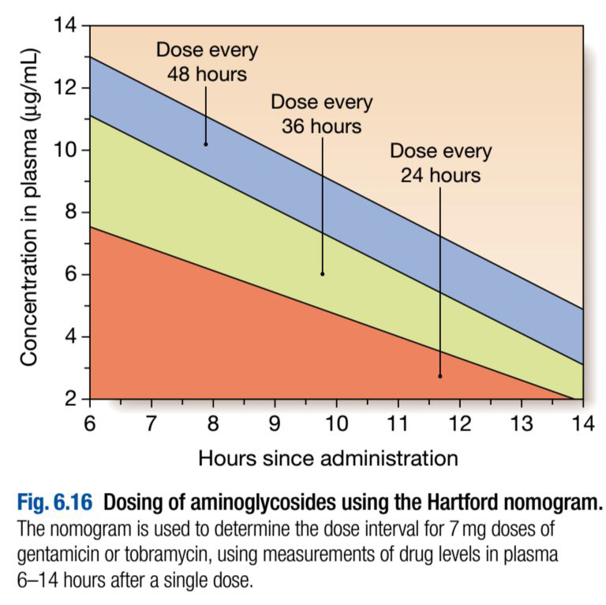

Slide 78
•In streptococcal and enterococcal endocarditis, gentamicin is used with a cell wall active agent (usually a β-lactam), to provide synergy. The usual dose is 1 mg/kg/day every 8 or 12 hours. Target pre- and post-dose levels are < 1 mg/L and 3–5 mg/L respectively.

Slide 79
•For other indications, gentamicin is administered 8- or 12-hourly at 3–5 mg/kg/day. Target pre- and post-dose levels are < 2mg/L and 5–10 mg/L (7–10 mg/L with less sensitive organisms, e.g. Pseudomonas spp.) respectively.
• For dosing of other aminoglycosides, consult local guidance.

Slide 80
Adverse reactions:
•Renal toxicity (usually reversible) accentuated by other nephrotoxic agents.
•Cochlear toxicity (permanent) more likely in older people and those with a predisposing mitochondrial gene mutation.
•Neuromuscular blockade after rapid i.v. infusion (potentiated by calcium channel blockers, myasthenia gravis and hypomagnesaemia).

Slide 81
Quinolones and fluoroquinolones:
These are bactericidal agents that are usually well tolerated and effective.
The quinolones have purely anti-Gram-negative activity, whereas the fluoroquinolones are broad-spectrum agents.

Slide 82
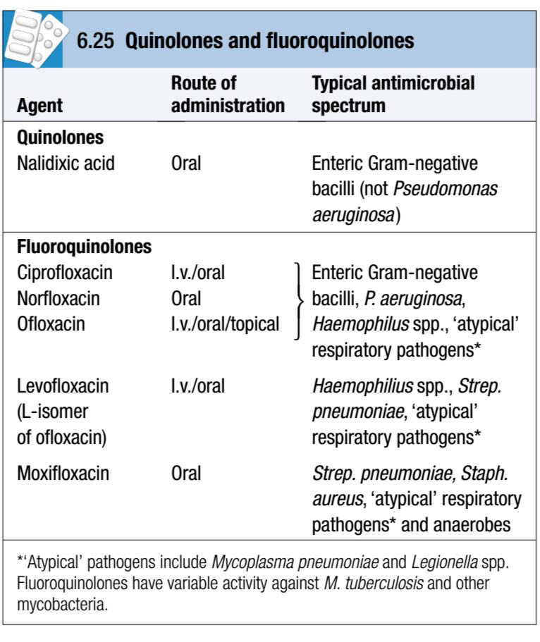

Slide 83
Ciprofloxacin has anti-pseudomonal activity but resistance emerges rapidly.
In Europe in 2006 between 5 and 48% of invasive E. coli isolates were resistant to ciprofloxacin.

Slide 84
Pharmacokinetics:
•Well absorbed after oral administration but delayed by food, antacids, ferrous sulphate and multivitamins. Excellent anti-Gram-negative activity.
•Wide volume of distribution; tissue concentrations twice those in serum.
•Good intracellular penetration, concentrating in phagocytes.

Slide 85
Adverse reactions:
•Gastrointestinal side-effects in 1–5%.
•Rare skin reactions (phototoxicity).
•Achilles tendon rupture is reported, especially in older people.
•CNS effects (confusion, tremor, dizziness and occasional seizures in 5–12%), especially in older people.

Slide 86
•Reduces clearance of xanthines and theophyllines, potentially inducing insomnia and increased seizure potential.
•Reports of prolongation of QT interval on ECG with newer fluoroquinolones.

Slide 87
•Cases of hypo- or hyperglycaemia in association with gatifloxacin, so glucose monitoring is needed in patients with diabetes or those with severe hepatic dysfunction.
•Quinolone use is associated with the acquisition of MRSA and emergence of a highly virulent strain of C. difficile (ribotype 027).

Slide 88
Glycopeptides:
Glycopeptides (vancomycin and teicoplanin) are only effective against Gram-positive organisms, and are used against MRSA and ampicillin-resistant enterococci.
Some staphylococci and enterococci demonstrate intermediate sensitivity or resistance.

Slide 89
Vancomycin use should be restricted, particularly in the management of C. difficile infections, to limit emergence of resistant strains.
Teicoplanin is not available in all countries.
Neither drug is absorbed after oral administration, but vancomycin is used orally in the treatment of C. difficile infection.

Slide 90
Pharmacokinetics:
Vancomycin:
•Administered by slow i.v. infusion, good tissue distribution and short half-life.
•Enters CSF only in the presence of inflammation.
•Therapeutic monitoring of i.v. vancomycin is recommended, to maintain pre-dose levels of > 10mg/L (10–20mg/L in serious staphylococcal infections).
Teicoplanin:
• Long half-life allows once-daily dosing.

Slide 91
Adverse effects:
•Histamine release due to rapid vancomycin infusion produces a ‘red man’ reaction (rare with modern preparations).
•Nephrotoxicity is rare, but may occur with concomitant aminoglycoside use.
•Teicoplanin can cause rash, bronchospasm, eosinophilia and anaphylaxis.

Slide 92
Folate antagonists:
These bacteriostatic antibiotics interfere with the prokaryotic cell metabolism of para-aminobenzoic acid to folic acid.
A combination of a sulphonamide and either trimethoprim or pyrimethamine is most commonly used and interferes with two consecutive steps in the metabolic pathway.

Slide 93
Combinations in use include trimethoprim/sulfamethoxazole (co-trimoxazole) and pyrimethamine with either sulfadoxine (used to treat malaria) or sulfadiazine (used in toxoplasmosis).
Co-trimoxazole in high dosage (120mg/kg daily in 2–4 divided doses) is the first-line drug for Pneumocystis jirovecii (carinii) infection in HIV disease.

Slide 94
The clinical use of these agents is limited by adverse effects.
Folate supplements should be given if these agents are used in pregnancy.

Slide 95
Pharmacokinetics:
•Well absorbed orally.
•Sulphonamides are hydrophilic, distributing well to the extracellular fluid.
•Trimethoprim is lipophilic with high tissue concentrations.

Slide 96
Adverse reactions:
•Trimethoprim is generally well tolerated with few adverse effects.
•Sulphonamides and dapsone may cause haemolysis in glucose-6-phosphate dehydrogenase deficiency.
•Sulphonamides and dapsone cause skin and mucocutaneous reactions including Stevens-Johnson syndrome and ‘dapsone syndrome’ (rash, fever and lymphadenopathy).

Slide 97
•Dapsone causes methaemoglobinaemia and peripheral neuropathy.
•Adverse effects of co-trimoxazole relate mainly to the sulphonamide component, and increase with dose and duration.

Slide 98
Tetracyclines and glycylcyclines:
Tetracyclines:
Of this mainly bacteriostatic class, the newer drugs doxycycline and minocycline show better absorption and distribution than older ones.
Most streptococci and Gram-negative bacteria are now resistant, in part due to use in animals (which is banned in Europe).

Slide 99
Tetracyclines are indicated for Mycoplasma spp., Chlamydia spp., Rickettsia spp., Coxiella spp., Bartonella spp., Borreliaspp., Helicobacter pylori, Treponema pallidum and atypical mycobacterial infections.
Minocycline is occasionally used in chronic staphylococcal infections.

Slide 100
Pharmacokineticsis:
Best oral absorption is in the fasting state (doxycycline is 100% absorbed unless gastric pH rises).

Slide 101
Adverse reactions:
•All tetracyclines except doxycycline are contraindicated in renal failure.
•Dizziness with minocycline.
•Binding to metallic ions in bones and teeth causes discoloration (avoid in children and pregnancy) and enamel hypoplasia.
•Phototoxic skin reactions.

Slide 102
Glycylcyclines (tigecycline):
Chemical modification of tetracycline has produced tigecycline, a broad-spectrum parenteral-only antibiotic with activity against resistant Gram-positive and Gram-negative pathogens such as MRSA and ESBL (but excluding Pseudomonas spp.).
Tigecycline has prominent gastrointestinal side-effects.

Slide 103
Nitroimidazoles (metronidazole, tinidazole):
Nitroimidazoles are highly active against strictly anaerobic bacteria, especially B. fragilis, C. difficile and other Clostridium spp.
They also have significant anti-protozoal activity against amoebae and Giardia lamblia.

Slide 104
Pharmacokinetics:
•Almost completely absorbed after oral administration (60% after rectal administration).
•Well distributed, especially to brain and CSF.
•Safe in pregnancy.

Slide 105
Adverse effects:
•Metallic taste (dose-dependent).
•Severe vomiting if taken with alcohol—‘Antabuse effect’.
•Peripheral neuropathy with prolonged use.

Slide 106
Other antibacterial agents:
Chloramphenicol:
This is a potent and cheap antibiotic, still widely prescribed throughout the world despite its potential toxicity.
Its use, however, is increasingly reserved for severe and life-threatening infections where other antibiotics are either unavailable or impractical.

Slide 107
It is bacteriostatic to most organisms but apparently bactericidal to H. influenzae, Strep. pneumoniae and N. meningitidis.
It has a very broad spectrum of activity against aerobic and anaerobic organisms, spirochaetes, Rickettsia, Chlamydia and Mycoplasma spp.

Slide 108
It also has quite useful activity against anaerobes such as Bacteroides fragilis.
It competes with macrolides and lincosamides for ribosomal binding sites, so should not be used in combination with these agents.

Slide 109
Pharmacokinetics:
•Well absorbed after i.v. or oral dose (not i.m.). Good tissue distribution and levels.
• Good CSF levels.
• Crosses placenta and reaches breast milk.

Slide 110
Adverse reactions:
•Dose-dependent ‘grey baby’ syndrome in infants (cyanosis and circulatory collapse due to inability to conjugate drug and excrete active form in urine).
•Reversible dose-dependent bone marrow depression in adults if > 4g per day administered or cumulative dose > 25g.
• Severe idiopathic aplastic anaemia in 1:25000–40000 exposures (unrelated to dose, duration of therapy or route of administration).

Slide 111
Daptomycin:
Daptomycin is a cyclic lipopeptide which has bactericidal activity against Gram-positive organisms (including MRSA and GRE) but no activity against Gram-negatives.
It is not absorbed orally, and is used intravenously to treat resistant Gram-positive infections, e.g. soft tissue infections and infective endocarditis, where other options are not available.

Slide 112
Fusidic acid:
This antibiotic, active against Gram-positive bacteria, is available in intravenous, oral or topical formulations.
It is lipid-soluble and distributes well to tissues.
However, its antibacterial activity is unpredictable.

Slide 113
Fusidic acid is used in combination, typically with anti-staphylococcalpenicillins, or for MRSA with clindamycin or rifampicin.
It interacts with coumarin derivatives and oral contraceptives.

Slide 114
Nitrofurantoin:
This drug has very rapid renal elimination and is active against aerobic Gram-negative and Gram-positive bacteria, including enterococci.
It is used only for treatment of urinary tract infection, being generally safe in pregnancy and childhood.
However, it can produce eosinophilic lung infiltrates, fever, pulmonary fibrosis, peripheral neuropathy, hepatitis and haemolytic anaemia.

Slide 115
Linezolid:
Linezolid is the only currently licensed member of the oxazolidinone class, which shows excellent oral absorption with good activity against Gram-positive organisms, including MRSA and GRE.
It is competitively inhibited by co-administration of chloramphenicol, vancomycin or clindamycin.

Slide 116
It appears to be very safe, although mild gastrointestinal side-effects and tongue discoloration are common.
Myelodysplasia and peripheral neuropathy can occur with prolonged use.

Slide 117
Co-administration with monoamine oxidase inhibitors or serotonin re-uptake inhibitor antidepressants should be avoided, as it may precipitate a serotonin syndrome (neuromuscular effects, autonomic hyperactivity and altered mental status).

Slide 118
Spectinomycin:
Chemically similar to the aminoglycosides and given intramuscularly, spectinomycin was developed to treat strains of N. gonorrhoeae resistant to β-lactam antibiotics.

Slide 119
Unfortunately, resistance to spectinomycin is very common and its only indication is the treatment of gonococcal urethritis in pregnancy or in patients allergic to β-lactam antibiotics.

Slide 120
Streptogramins:
Quinupristin/dalfopristin (supplied as a 30:70% combination) is active against MRSA and GRE (Enterococcus faecium but not E. faecalis), and its use should be reserved for these organisms.

Slide 121
It is available in intravenous formulation only and shows good tissue penetration, but does not cross the blood–brain barrier or the placenta.
Significant phlebitis occurs at injection sites and a raised serum creatinine and eosinophilia may occur.

Slide 122
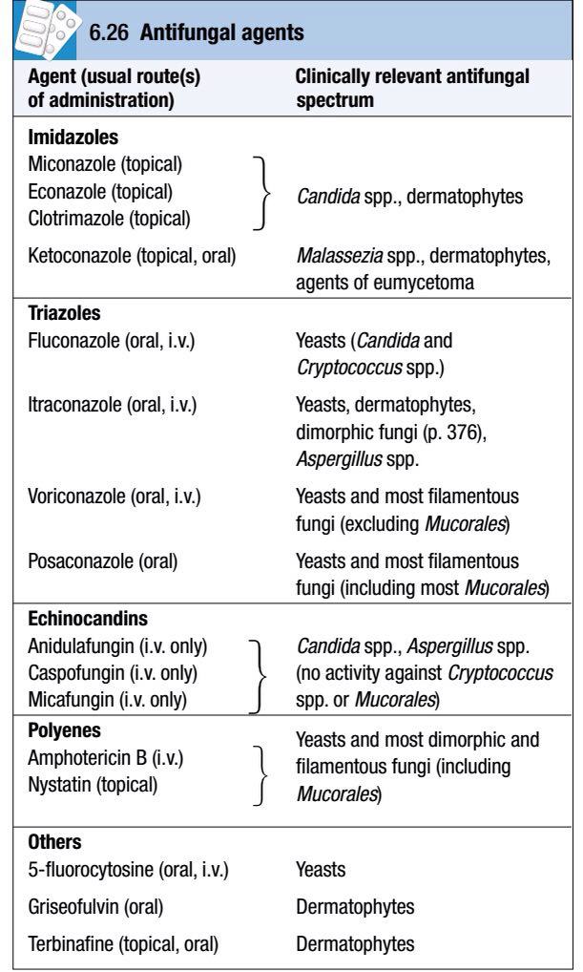
Antifungal agents:

Slide 123
1. Azole antifungals:
The azoles (imidazoles and triazoles) inhibit synthesis of ergosterol, a key constituent of the fungal cell membrane.
Side-effects vary but include gastrointestinal upset, hepatitis and rash.

Slide 124
Azoles are amongst the drugs metabolised by cytochrome p450 enzymes, so must be used cautiously if combined with other such drugs with which they may interact.

Slide 125
Imidazoles:
Miconazole, econazole, clotrimazole and ketoconazole are relatively toxic and therefore mainly administered topically.
Clotrimazole is used extensively to treat superficial fungal infections.

Slide 126
Ketoconazole may be given orally, but causes severe hepatitis in ∼1:15000 cases and inhibits enzymes involved in steroid biosynthesis in the adrenals and gonads.
Triazoles are preferred for systemic administration because of their reduced toxicity.

Slide 127
Triazoles:
Fluconazole is effective against yeasts only (Candida and Cryptococcus spp.).
It is well absorbed after oral administration, and has a long half-life (approximately 30 hours) and an excellent safety profile.
The drug is highly water-soluble and distributes widely to all body sites and tissues, including CSF.

Slide 128
Itraconazole is lipophilic and distributes extensively, including to toenails and fingernails.
CSF penetration is poor.
Oral absorption is erratic and formulation-dependent, which necessitates monitoring of blood levels.

Slide 129
Voriconazole is extremely well absorbed (96% oral bioavailability) and is used mainly in the treatment of aspergillosis.
Posaconazole is the broadest-spectrum antifungal azole, and the only one with consistent activity against the Mucorales. It is currently available as an oral agent only.

Slide 130
2. Echinocandins:
Anidulafungin, caspofungin and micafungin inhibit β-1,3-glucan synthesis in the fungal cell wall.
They do not demonstrate cross-resistance with azoles or polyenes and have very few significant adverse effects.
Caspofungin, anidulafungin and micafungin are used to treat candidaemia, and caspofungin is also used in aspergillosis.

Slide 131
3. Polyenes:
Amphotericin B deoxycholate causes cell death by binding to ergosterol and damaging the fungal cytoplasmic membrane.
Its use in resource-rich countries is being supplanted by less toxic antifungal agents.
It is lipophilic, insoluble in water and not absorbed orally.
Its long half-life enables once-daily administration.
CSF penetration is poor.

Slide 132
Adverse reactions include immediate anaphylaxis (a test dose should always be given before infusion), other infusion-related reactions, and nephrotoxicity.
Nephrotoxicity may be sufficient to require dialysis, and occurs in most patients who are adequately dosed.

Slide 133
It may be ameliorated by concomitant infusion of normal saline.
Irreversible nephrotoxicity occurs with large cumulative doses of amphotericin B.

Slide 134
Nystatin has a similar spectrum of antifungal activity to amphotericin B.
Its toxicity limits it to topical use, e.g. in oral and vaginal candidiasis.

Slide 135
Lipid formulations of amphotericin B:
Lipid formulations of amphotericin B (AmB) have been developed to reduce the toxicity of the parent compound.
These consist of AmB encapsulated in liposomes (liposomal AmB, L-AmB) or complexed with phospholipids (AmB lipid complex, ABLC) or cholesteryl sulphate (AmB colloidal dispersion, ABCD).

Slide 136
The drug becomes active dissociating from its lipid component after administration.
Adverse reactions are similar to, but considerably less frequent than, those with AmB deoxycholate, and efficacy is similar.
Lipid formulations of AmB are used as empirical therapy in patients with neutropenic fever and also in visceral leishmaniasis.

Slide 137
Other antifungal agents:
5-fluorocytosine:
This drug has particular activity against yeasts.
When used as monotherapy, resistance develops rapidly, so it should be administered in combination with another antifungal agent.
Oral dosing is effective.
Adverse reactions include myelosuppression, gastrointestinal upset and hepatitis.

Slide 138
Griseofulvin:
Griseofulvin has been largely superseded by terbinafine and itraconazole for treatment of dermatophyte infections, except in children, for whom these agents remain unlicensed.
It demonstrates excellent oral bioavailability and is deposited in keratin precursor cells, which become resistant to fungal invasion.

Slide 139
The duration of treatment is 2–4 weeks for tinea corporis/capitis, 4–8 weeks for tinea pedis, and 4–6 months for onychomycosis (fungal nail infections).

Slide 140
Terbinafine:
Terbinafine is well absorbed orally, can be given once daily and distributes with high concentration to sebum and skin with a half-life of greater than 1 week.
It is used topically for skin infections and orally for onychomycosis (nail infections).

Slide 141
The major adverse reaction is hepatic toxicity (approximately 1:50000 cases).
Terbinafine is not recommended for breastfeeding mothers and should not be applied vaginally.

Slide 142
Antiviral agents:
Most viral infections in immunocompetent individuals resolve without intervention.
Antiviral therapy is available only for a limited number of infections.

Slide 143
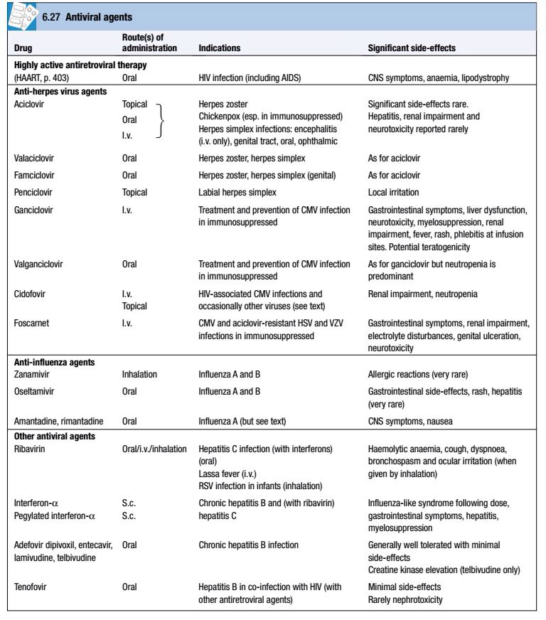

Slide 144
Anti-herpes virus agents:
a.Aciclovir, valaciclovir, penciclovir and famciclovir:
Aciclovir, valaciclovir, penciclovir and famciclovir are acyclic analogues of guanosine, which inhibit viral DNA polymerase after being phosphorylated by virus-derived thymidine kinase (TK).

Slide 145
Aciclovir is slowly and incompletely absorbed after oral dosing; much better levels are achieved intravenously or by use of the pro-drug valaciclovir.
Famciclovir is the pro-drug of penciclovir.
Resistance is mediated by mutations in the viral kinase or polymerase.

Slide 146
b.Ganciclovir:
Chemical modification of the aciclovir molecule allows preferential phosphorylation by protein kinases of CMV and other β-herpesviruses (e.g. HHV6/7) and hence greater inhibition of the DNA polymerase, but at the expense of increased toxicity.
Ganciclovir is administered intravenously or as a pro-drug (valganciclovir) orally.

Slide 147
c.Cidofovir:
Cidofovir inhibits viral DNA polymerases with potent activity against CMV, including most ganciclovir-resistant CMV.
It also has activity against aciclovir-resistant HSV and VZV, human herpes virus 6 and occasionally adenovirus, pox virus, papillomavirus or polyoma virus, and may be used to treat these infections in immunocompromised hosts.

Slide 148
d.Foscarnet:
This analogue of inorganic pyrophosphate acts as a non-competitive inhibitor of HSV, VZV, HHV6/7 or CMV DNA polymerase.
It does not require significant intracellular phosphorylation and so may be effective when HSV or CMV resistance is due to altered phosphorylation of the antiviral substrate.
It has variable CSF penetration.

Slide 149
Anti-influenza agents:
a. Zanamivir and oseltamivir:
These agents inhibit the neuraminidase enzyme in influenza A and B, which is required for release of virus from infected cells.
They are used in treatment and prophylaxis of influenza.

Slide 150
Administration within 48 hours of disease onset reduces the duration of symptoms by approximately 1–1 ¹⁄2 days.
In the UK their use is limited mainly to adults with chronic respiratory or renal disease, significant cardiovascular disease, immunosuppression or diabetes mellitus, during known outbreaks.

Slide 151
b.Amantadine and rimantadine:
These drugs reduce replication of influenza A by inhibition of viral M2 protein ion channel function, which is required for uncoating.
Resistance develops rapidly and is widespread, and they should be used only if local prevalence of resistant strains is known to be low.

Slide 152
They are no longer recommended for either treatment or prophylaxis in the UK or USA, having been superseded by zanamivir and oseltamivir.
However, they may still be indicated to treat oseltamivir-resistant influenza A strains in patients unable to take zanamavir (e.g. ventilated patients).

Slide 153
Other antiviral agents:
Ribavirin:
Ribavirin is a guanosine analogue that inhibits nucleic acid synthesis in a variety of viruses.

Slide 154
Lamivudine, adefovir dipivoxil,tenofovir, entecavir and telbivudine:
These agents have excellent activity against hepatitis B virus DNA polymerase-reverse transcriptase.
They are well tolerated after oral administration but resistance develops with monotherapy.

Slide 155
Resistance seems to emerge most rapidly for lamivudine (via the tyrosine-methionine-aspartate-aspartate, or YMDD, mutation) and slowly for entecavir (multiple mutations required).
Organisms resistant to lamivudine are usually also resistant to telbivudine, but not to adefovir/tenofovir.

Slide 156
The role of monotherapy for HBV is currently a matter for debate, and combination therapy, as used in HIV treatment, is likely to be used increasingly.
Lamivudine and tenofovir are also used against HIV.

Slide 157
Interferon-α:
The interferons are naturally occurring cytokines that are produced as an early response to viral infection.
The addition of a polyethylene glycol (PEG) moiety to the molecule significantly enhances pharmacokinetics and efficacy.

Slide 158
Antiparasitic agents:
Drugs used against helminths:
a.Benzimidazoles (albendazole, mebendazole):
These agents act by inhibiting both helminth glucose uptake, causing depletion of glycogen stores, and fumarate reductase.
Albendazole is used in hookworm, ascariasis, threadworm, Strongyloides infection, trichinellosis, Taenia solium (cysticercosis) and hydatid disease.

Slide 159
Mebendazole is used for hookworm, ascariasis, threadworm and whipworm.
The drugs are administered orally.
Absorption is relatively poor, but increased by a fatty meal.
Significant adverse reactions are uncommon.

Slide 160
b.Bithionol:
Bithionol is used to treat fluke infections with Fasciola hepatica.
It is well absorbed orally.
Adverse reactions are mild (e.g. nausea, vomiting, diarrhoea, rashes) but relatively common (approximately 30%).

Slide 161
c. Diethylcarbamazine (DEC):
DEC is an oral agent used to treat filariasis and loiasis.
Treatment of filariasis is often followed by fever, headache, nausea, vomiting, arthralgia and prostration.
This is caused by the host response to dying microfilariae, rather than the drug, and may be reduced by pre-treatment with corticosteroids.

Slide 162
d. Ivermectin:
Ivermectin binds to helminth nerve and muscle cell ion channels, causing increased membrane permeability.
It is an oral agent, used in Strongyloides infection, filariasis and onchocerciasis.
Significant side-effects are uncommon.

Slide 163
e. Niclosamide:
Niclosamide inhibits oxidative phosphorylation, causing paralysis of helminths.
It is an oral agent, used in Taenia saginata and intestinal T. solium infection.
Systemic absorption is minimal, and it has few significant side-effects.

Slide 164
f. Piperazine:
Piperazine inhibits neurotransmitter function, causing helminth muscle paralysis.
It is an oral agent, used in ascariasis and threadworm (Enterobius vermicularis) infection.
Significant adverse effects are uncommon, but include neuropsychological reactions such as vertigo, confusion and convulsions.

Slide 165
g. Praziquantel:
Praziquantel increases membrane permeability to Ca⁺⁺, causing violent contraction of worm muscle.
It is the drug of choice for schistosomiasis, and is also used in T. saginata, T. solium (cysticercosis), fluke infections (Clonorchis, Paragonimus) and echinococcosis.

Slide 166
It is administered orally and well absorbed.
Adverse reactions are usually mild and transient, and include nausea and abdominal pain.

Slide 167
h. Pyrantel pamoate:
This agent causes spastic paralysis of helminth muscle through a suxamethonium-like action.
It is used orally in ascariasis and threadworm infection.
Systemic absorption is poor, and adverse effects are uncommon.

Slide 168
i. Thiabendazole:
Thiabendazole inhibits fumarate reductase, which is required for energy production in helminths.
It is used orally in Strongyloides infection and topically to treat cutaneous larva migrans.
Significant adverse effects are uncommon.

Slide 169
Antimalarial agents:
a. Artemisinin (quinghaosu) derivatives:
Artemisinin originates from a herb (sweet wormwood, Artemisia annua), which was used in Chinese medicine to treat fever.
Its derivatives, artemether and artesunate, were developed for use in malaria in the 1970s.
Their mechanism of action is unknown.

Slide 170
They are used in the treatment, but not prophylaxis, of malaria, usually in combination with other antimalarials, and are effective against strains of Plasmodium spp. that are resistant to other antimalarials.
Artemether is lipid-soluble, and may be administered via intramuscular and oral routes.

Slide 171
Artesunate is water-soluble and is administered intravenously or orally.
Serious adverse effects are uncommon.
Current advice for malaria in pregnancy is that the artemisinin derivatives should be used to treat uncomplicated falciparum malaria in the second and third trimesters, but should not be used in the first trimester until more information becomes available.

Slide 172
b. Atovaquone:
Atovaquone inhibits mitochondrial function.
It is an oral agent, used for treatment and prophylaxis of malaria, in combination with proguanil, without which it is ineffective.

Slide 173
It is also used in the treatment of Pneumocystis jirovecii (carinii) pneumonia where there is intolerance to co-trimoxazole.
Significant adverse effects are uncommon.

Slide 174
c. Folate synthesis inhibitors (proguanil, pyrimethamine-sulfadoxine):
Proguanil inhibits dihydrofolate reductase, and is used for malaria prophylaxis.
Pyrimethamine-sulfadoxine is used in the treatment of malaria.

Slide 175
d. Quinoline-containing compounds:
Chloroquine and quinine are believed to act by intra-parasitic inhibition of haem polymerisation, resulting in toxic build-up of intracellular haem.
The mechanisms of action of other agents in this group (quinidine, amodiaquine, mefloquine, primaquine, etc.) may differ.

Slide 176
They are used in the treatment and prophylaxis of malaria.
Primaquine is used for radical cure of malaria due to Plasmodium vivax and P. ovale (destruction of liver hypnozoites).
Chloroquine is also used in extra-intestinal amoebiasis.

Slide 177
Chloroquine can cause a pruritus sufficient to compromise compliance with therapy.
If used in long-term, high-dose regimens, it causes an irreversible retinopathy.
Overdosage causes life-threatening cardiotoxicity.

Slide 178
The side-effect profile of mefloquine includes neuropsychiatric effects ranging from mood change, nightmares and agitation to hallucinations and psychosis.
Quinine may cause hypoglycaemia and cardiotoxicity, especially when administered parenterally.

Slide 179
Primaquine causes haemolysis in people with glucose-6-phosphate dehydrogenase deficiency , which should be excluded before therapy.
Chloroquine is considered safe in pregnancy, but mefloquine should be avoided in the first trimester.

Slide 180
e. Lumefantrine:
Lumefantrine is used in combination with artemether to treat uncomplicated falciparum malaria, including chloroquine-resistant strains.
Its mechanism of action is unknown.
Significant adverse effects are uncommon.

Slide 181
Drugs used in trypanosomiasis:
a. Benznidazole:
Benznidazole is an oral agent used to treat South American trypanosomiasis (Chagas’ disease).
Significant and common adverse effects include dose-related peripheral neuropathy, purpuric rash and granulocytopenia.

Slide 182
b. Eflornithine:
Eflornithine inhibits biosynthesis of polyamines by ornithine decarboxylase inhibition, and is used in West African trypanosomiasis (T. brucei gambiense infection) of the CNS.
It is administered as a 6-hourly intravenous infusion, which may be logistically difficult in the geographic areas affected by this disease.

Slide 183
Significant adverse effects are common, and include convulsions, gastrointestinal upset and bone marrow depression.
Eflornithine is also used (topically) to treat hirsutism.

Slide 184
c. Melarsoprol:
This is an arsenical agent, which is used to treat CNS infections in both E. and W. African trypanosomiasis (T. brucei rhodesiense and gambiense).
It is administered intravenously.
Melarsoprol treatment is associated with peripheral neuropathy and reactive arsenical encephalopathy (RAE), which carries a significant mortality.

Slide 185
d. Nifurtimox:
Nifurtimox is administered orally to treat South American trypanosomiasis (Chagas’ disease).
Gastrointestinal and neurological adverse effects are common.

Slide 186
e. Pentamidine isetionate:
Pentamidine is an inhibitor of DNA replication used in West African trypanosomiasis (T. brucei gambiense) and, to a lesser extent, in visceral and cutaneous leishmaniasis.
It is also used in Pneumocystis jirovecii (carinii) pneumonia.

Slide 187
It is administered via intravenous or intramuscular routes.
It is a relatively toxic drug, commonly causing rash, renal impairment, profound hypotension (especially on rapid infusion), electrolyte disturbances, blood dyscrasias and hypoglycaemia.

Slide 188
f. Suramin:
Suramin is a naphthaline dye derivative, used to treat East African trypanosomiasis (T. brucei rhodesiense).
It is administered intravenously.
Adverse effects are common, and include rash, gastrointestinal disturbance, blood dyscrasias, peripheral neuropathies and renal impairment.

Slide 189
Other antiprotozoal agents:
Pentavalent antimonials:
Sodium stibogluconate and meglumine antimoniate inhibit protozoal glycolysis by phosphofructokinase inhibition.
They are used parenterally (intravenous or intramuscular) to treat leishmaniasis.

Slide 190
Adverse effects include arthralgia, myalgias, raised hepatic transaminases, pancreatitis and ECG changes. Severe cardiotoxicity leading to death is not uncommon.

Slide 191
Diloxanide furoate:
This oral agent is used to eliminate luminal cysts following treatment of intestinal amoebiasis, or in asymptomatic cyst excreters.
The drug is absorbed slowly (enabling luminal persistence) and has no effect in hepatic amoebiasis.
It is a relatively non-toxic drug, the most significant adverse effect being flatulence.

Slide 192
Iodoquinol (di-iodohydroxyquinoline):
Iodoquinol is a quinoline derivative with activity against Entamoeba histolytica cysts and trophozoites.
It is used orally to treat asymptomatic cyst excreters or, in association with another amoebicide (e.g. metronidazole), to treat extra-intestinal amoebiasis.

Slide 193
Long-term use of this drug is not recommended, as neurological adverse effects include optic neuritis and peripheral neuropathy.

Slide 194
Nitazoxanide:
Nitazoxanide is an inhibitor of pyruvate-ferredoxin oxidoreductase-dependent anaerobic energy metabolism in protozoa.
It is a broad-spectrum agent, active against various nematodes, tapeworms and flukes, as well as intestinal protozoa and some anaerobic bacteria and viruses.

Slide 195
It is administered orally in giardiasis and cryptosporidiosis.
Adverse effects are usually mild, and involve the gastrointestinal tract (e.g. nausea, diarrhoea and abdominal pain).

Slide 196
Paromomycin:
Paromomycin is an aminoglycoside, which is used to treat visceral leishmaniasis and intestinal amoebiasis.
It is not significantly absorbed when administered orally, and is therefore given orally for intestinal amoebiasis and by intramuscular injection for leishmaniasis.

Slide 197
It showed early promise in the treatment of HIV-associated cryptosporidiosis, but subsequent trials have demonstrated that this effect is marginal at best.

Slide 198
THE END

